Slide 1


Slide 2
Agenda
Data Science
Case Study: Analyzing Immomio PropertyTenants
Machine Learning
Supervised Learning
Unsupervised Learning
Neural Nets
Concept
Training a neural network

Slide 3
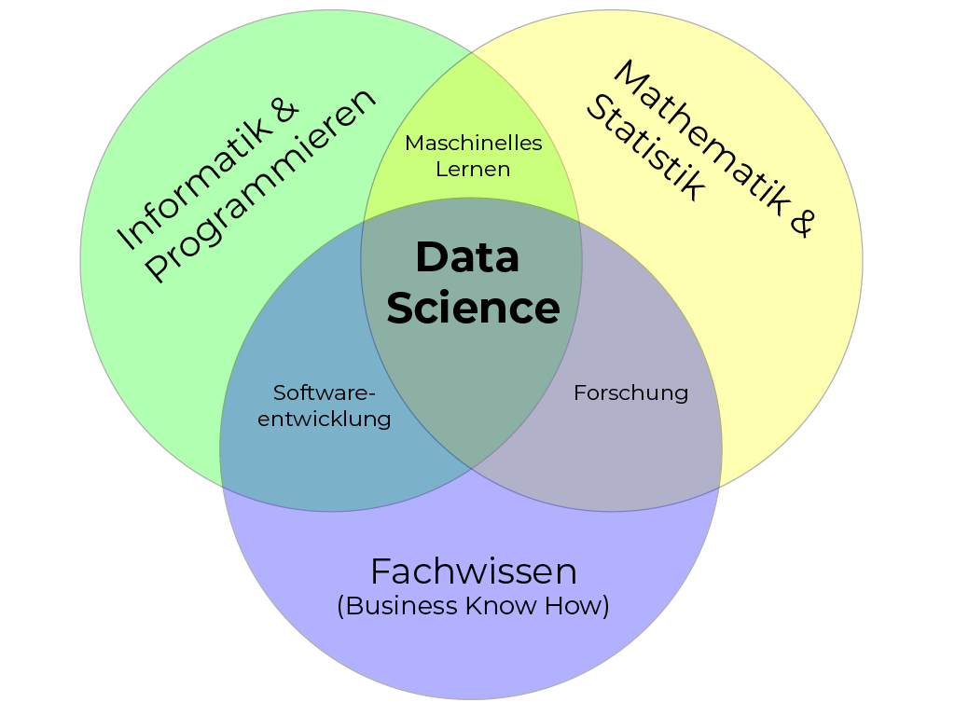
Data Science

Slide 4
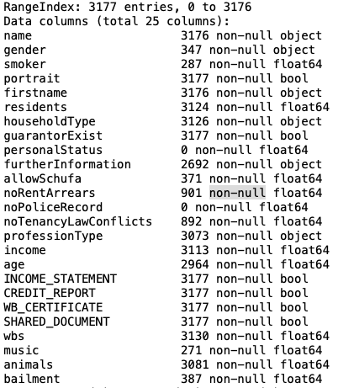
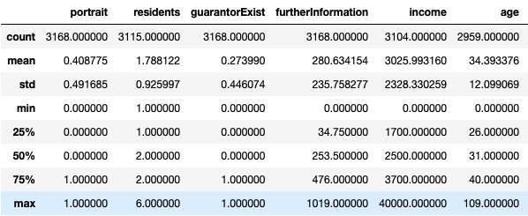
Analyzing Immomio PropertyTenants

Slide 5
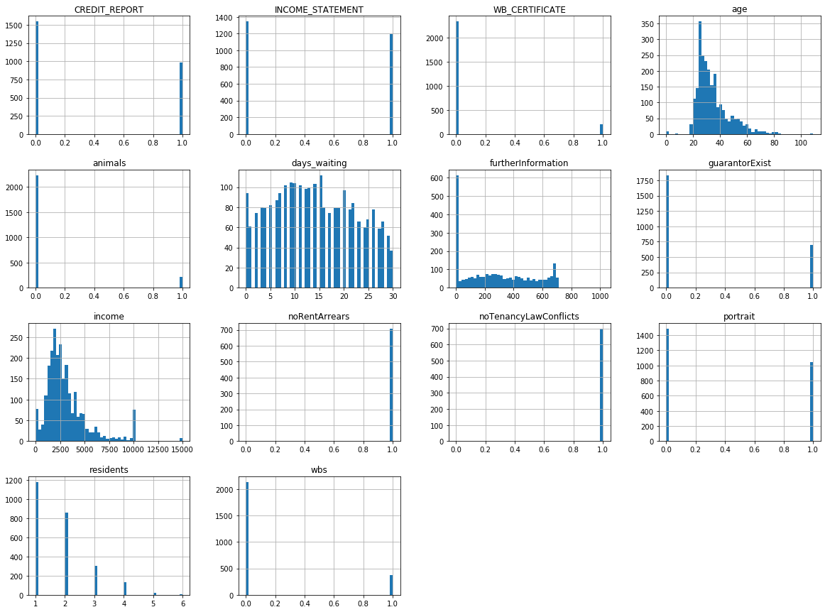
Histogram
m = 31
m = 14
m = 235
m = 2500
m = 2

Slide 6
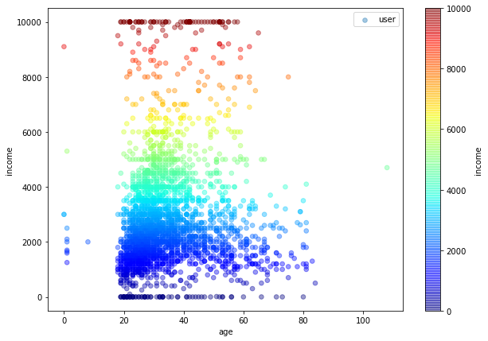
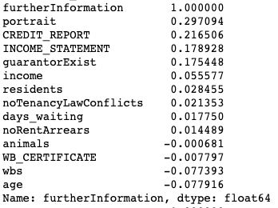
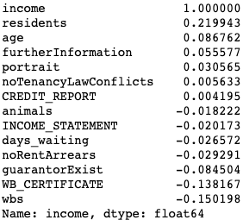
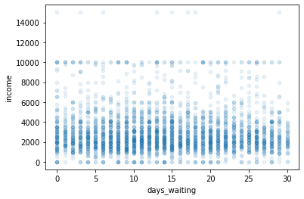
Correlations and Plots

Slide 7
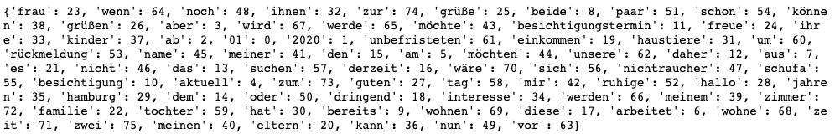
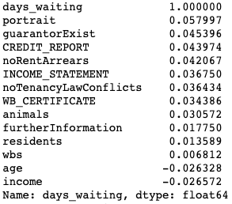
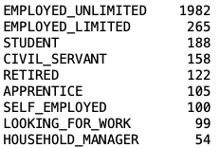
Further Information
Occurrence 5 – 10% among all texts

Slide 8
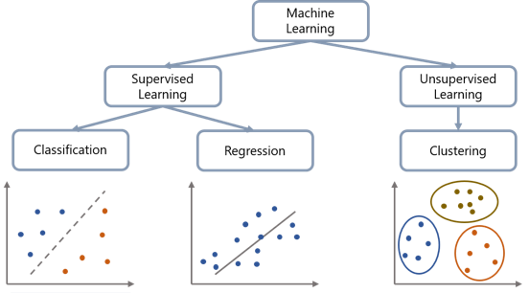
Machine Learning

Slide 9
Training Sets
Training Dataset: data used to fit the model.
model sees and learns from this
Validation Dataset: data used to provide an unbiased evaluation of a model fit while tuning model hyperparameters.
used to evaluate a given model, but for frequent evaluation
model occasionally sees this data, but never does it “Learn” from this
also known as the Dev set or the Development set
Test Dataset: used to provide an unbiased evaluation of a final model fit on the training dataset.
only used once a model is completely trained.
contains carefully sampled data that spans the various classes that the model would face, when used in the real world.

Slide 10
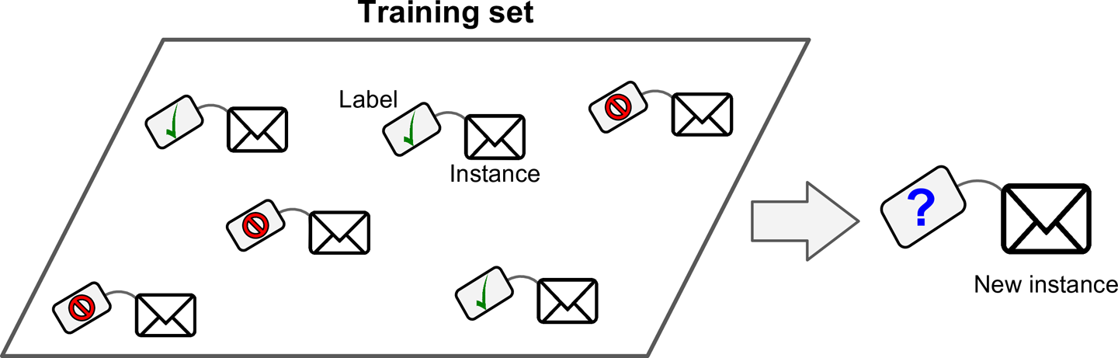
Supervised Learning

Slide 11
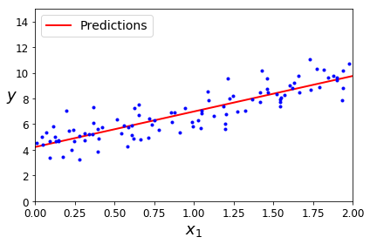
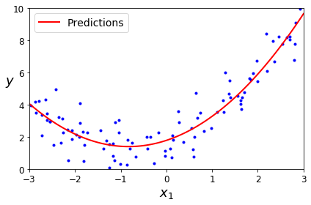
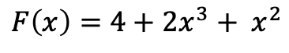
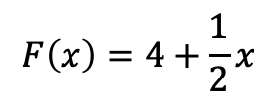
Regression - Computing output for new instance
$$F\left(x\right)=4+\frac{1}{2}x$$
$$F\left(x\right)=4+2x^{3}+ x^{2}$$

Slide 12
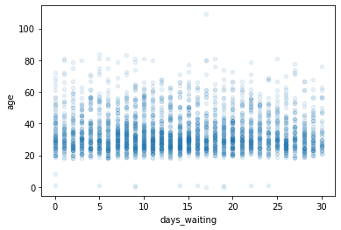
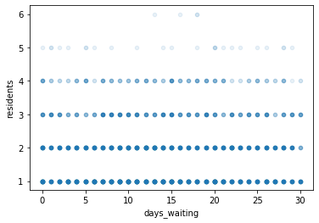
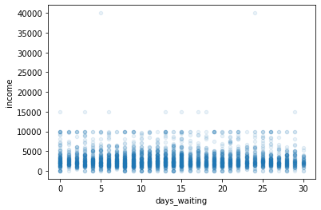
Which model to choose for our Tenants?

Slide 13
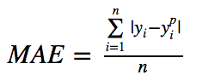
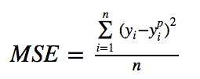
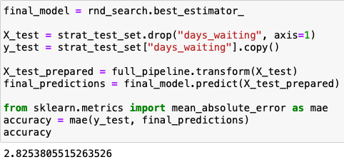
How to evaluate regression models?
Mean average error
Mean squared error
Average error across predictions
Average error across predictions
with more weight to outliners

Slide 14
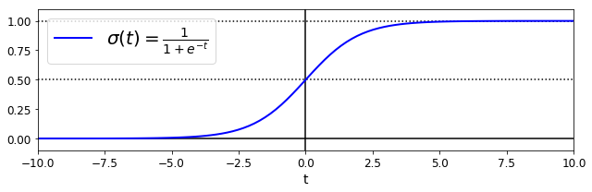
Classification – Classify new instance

Slide 15
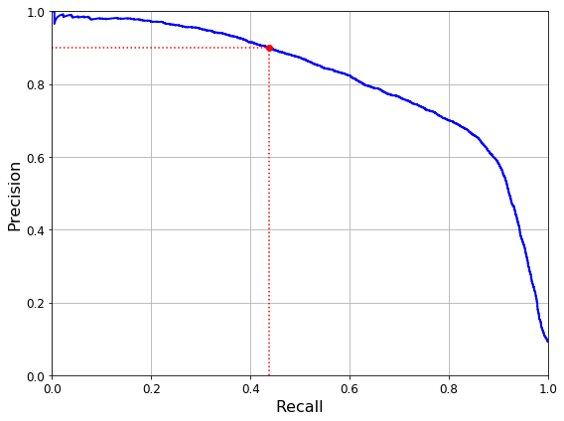
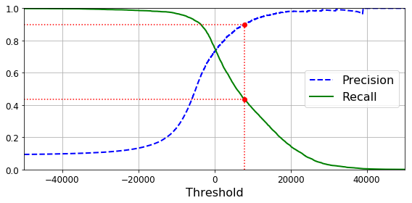
How to evaluate classification models?

Slide 16
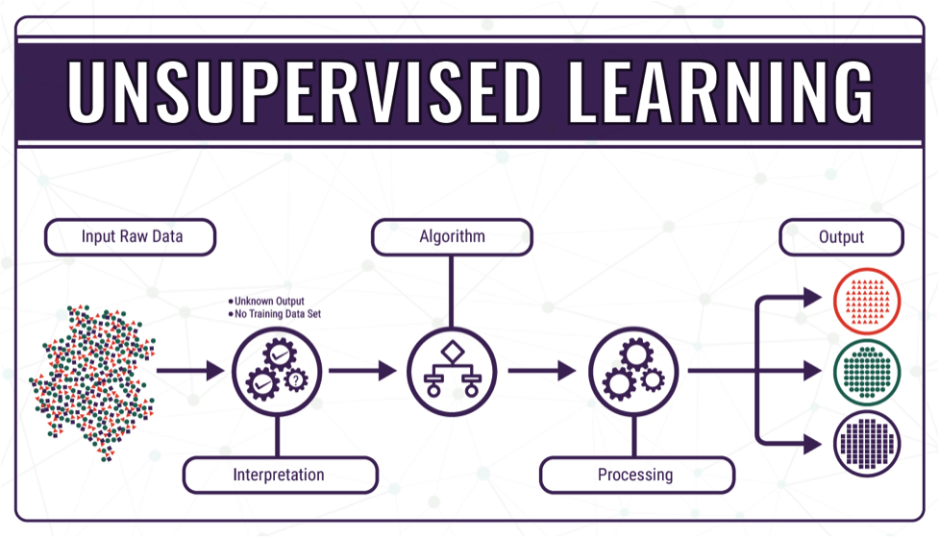

Slide 17
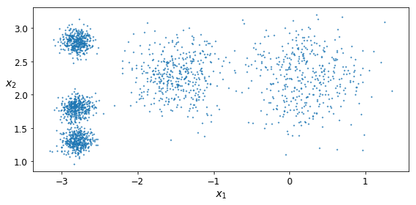
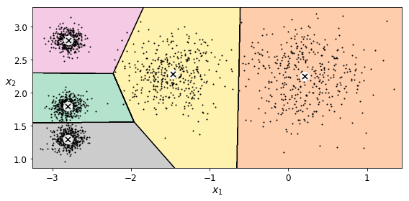
Clustering – Grouping similar instances

Slide 18
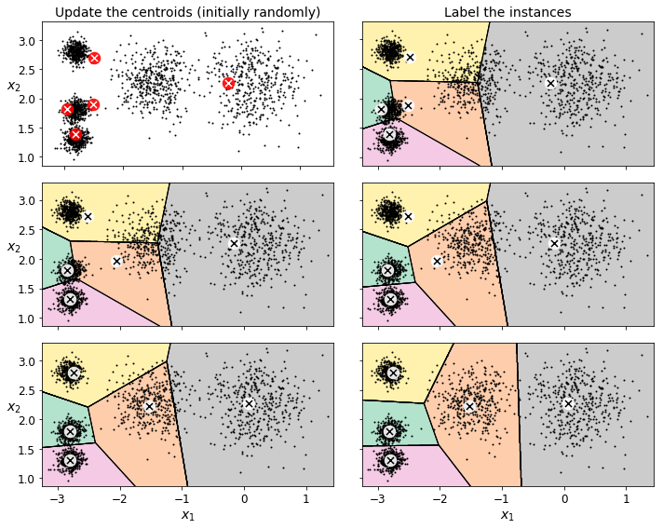
How does it work?

Slide 19
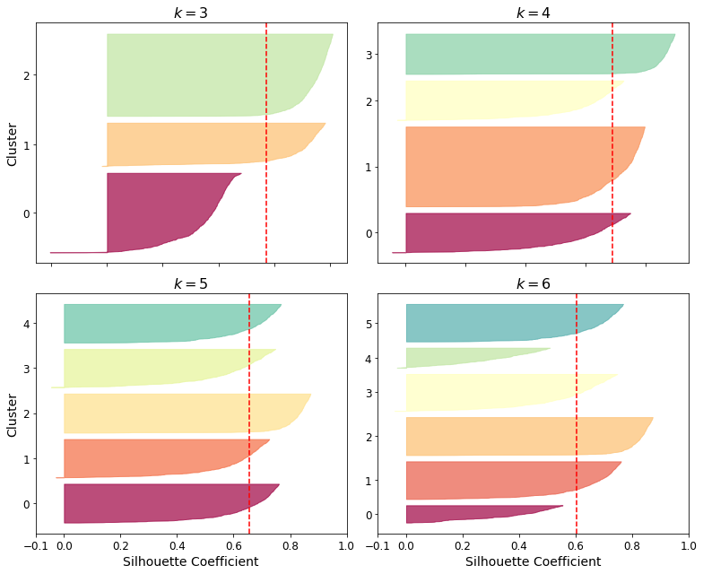
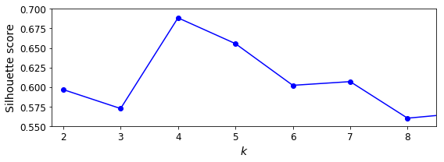
How to evaluate clustering?
Since we do not have the targets, we need another idea!
„inertia“: measure the distance between each instance and its centroid
But how to determine the optimal number of clusters?

Slide 20
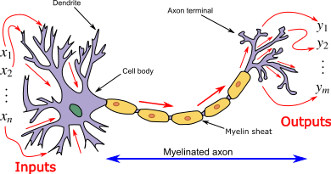
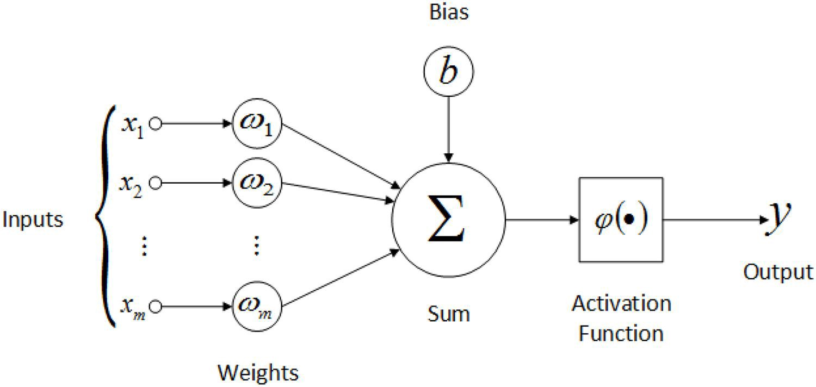
Neuronal nets
Human neuron
Artificial neuron

Slide 21
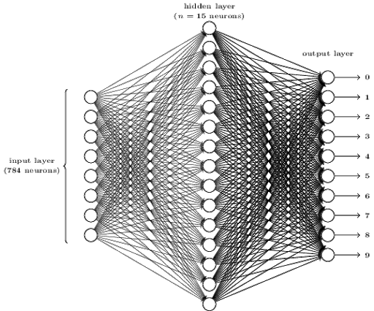
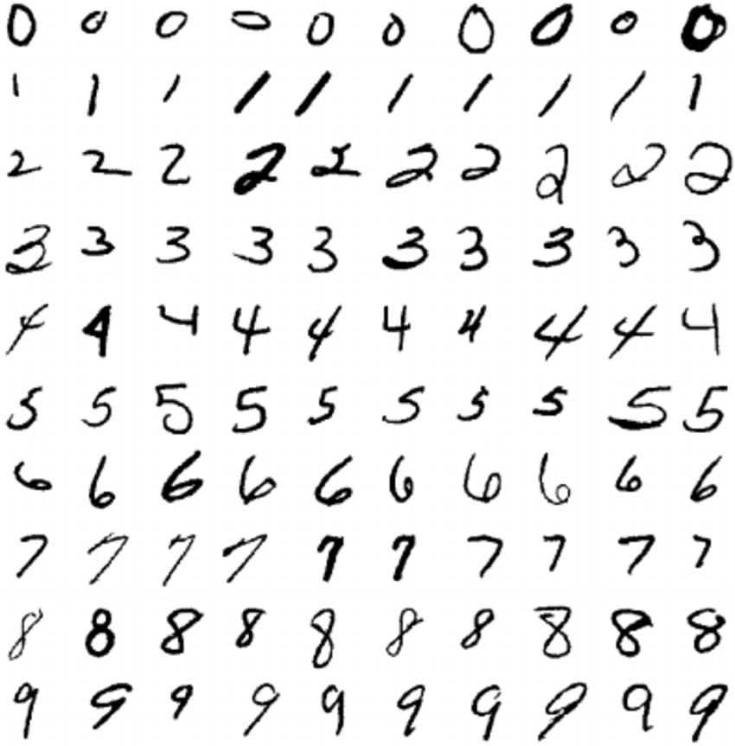

Slide 22
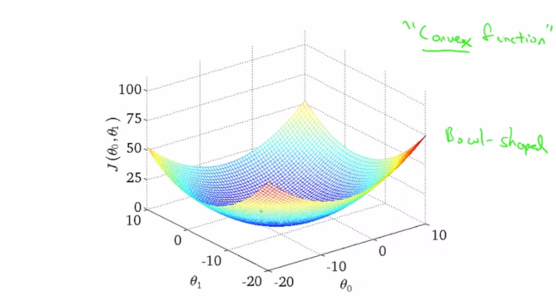
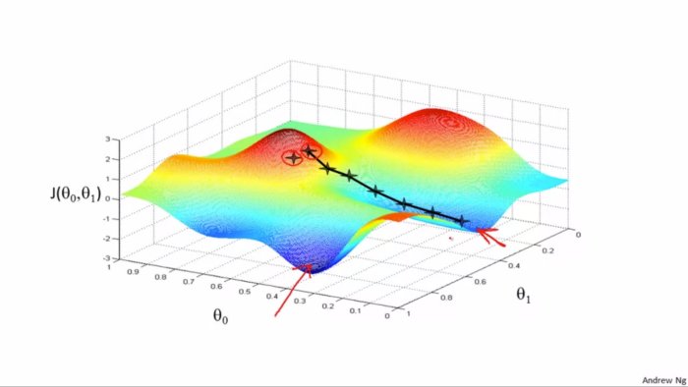
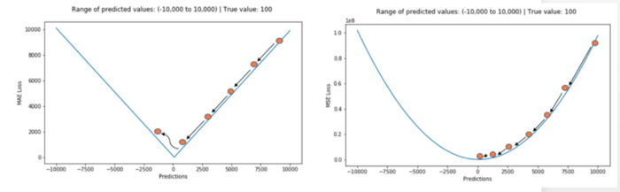
How does a model “learn”? – Gradient decent!

Slide 23
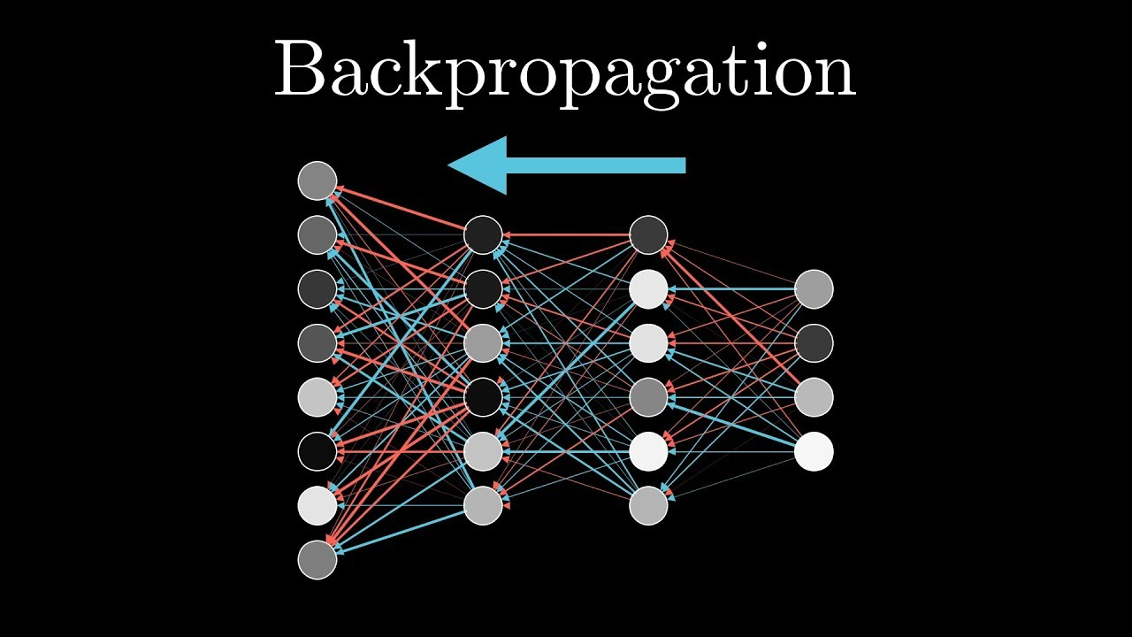
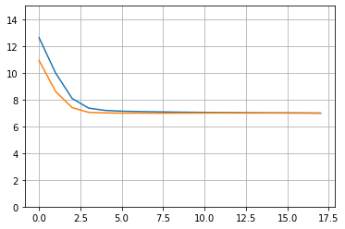

Slide 24
How can Immomio use these concepts?
Data Science:
Gain valuable information about customers and their behaviors
Anomaly detection - monitor activity and build transparency
Regression:
Supply useful information to PS and LL
Predict waiting times
Classification & Clustering:
Classify PS and LL – offer tailored solutions
Automation – ML applications can simplify automation (eg. Automatic invitation feature)
Rework SearchProfiles and Priosets

Slide 25

Let’s talk about

Slide 26
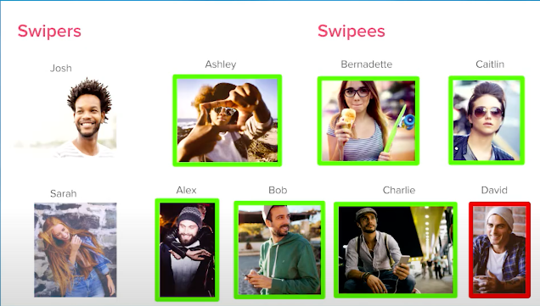

Slide 27
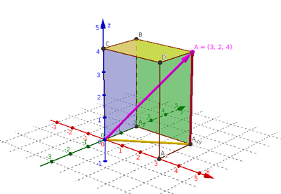
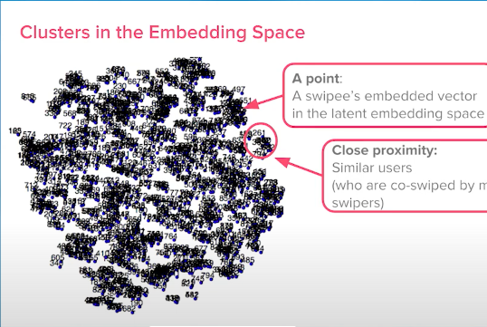

Slide 28
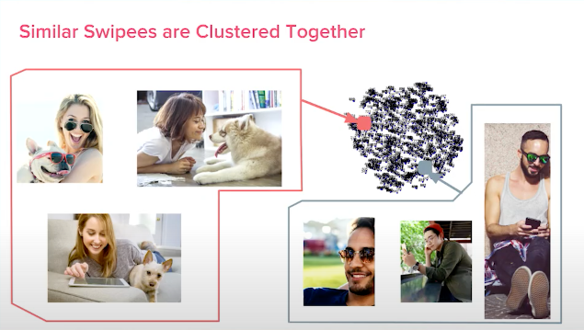

Slide 29
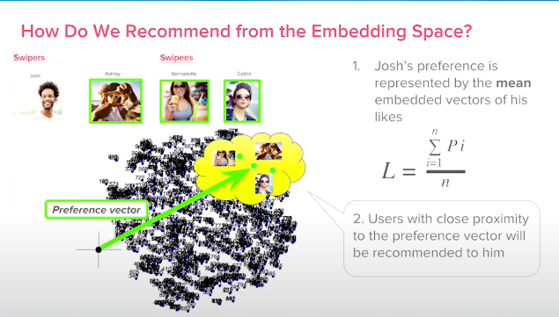

Slide 30

and a drink ☺

